Slide 1

PnP/PnPjs

Slide 2


Agenda
What is PnPjs
Why PnPjs
Basic Use Cases
Batching
Relationship to SPFx
Options to access SharePoint data from SPFx
Notes:
Grundet vores MS mand er blevet fordringer, afsætter vi ekstra tid til på Hands-on labs

Slide 3
What is PnPjs
Robust REST based library providing a fluent API
Monthly releases driven by community feedback
Constantly improving docs
Notes:
Grundet vores MS mand er blevet fordringer, afsætter vi ekstra tid til på Hands-on labs

Slide 4
Why PnPjs
Handles request digest and header settings
Ensures the correct JSON format and type values
Easily batch requests inline
Fluent API guides building your requests
Works with classic SharePoint, SPFx and Add-Ins
Notes:
Grundet vores MS mand er blevet fordringer, afsætter vi ekstra tid til på Hands-on labs

Slide 5
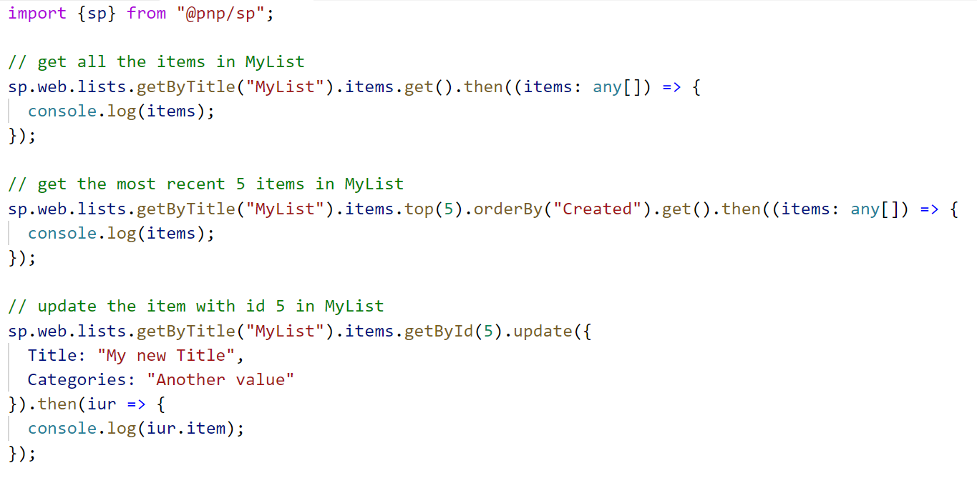
Basic Use Cases

Slide 6
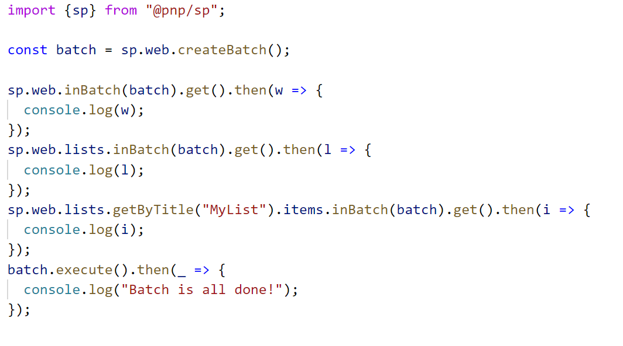
Batching

Slide 7
Relationship to SPFX
Compliments SPFx and make repetive tasks easier
Do I have to user PnPjs in SPFx? - No
Similar to relationship of PnP CSOM and SharePoint
What are other options?
Notes:
Grundet vores MS mand er blevet fordringer, afsætter vi ekstra tid til på Hands-on labs

Slide 8
Options to access SharePoint data from SPFx
 | JSOM | Raw REST | SPHttpClient | PnPjs
Characteristics | From SP2010 Mimics CSOM Works with delegates Doesn’t support Promises Not being developed anymore | Standard technology Easy for GET Complex for non-GET Evergreen | SPFx specific Easy for all kinds of requests For non-Get you need to create JSON Evergreen | Fluent API Works natively with promises Open-source community-driven
Future-proof | No | Yes | Yes | Yes
Coverage | Fair | Excellent | Excellent | Good
Ease of use | Hard | Moderate | Moderate+ | Easy

